Slide 1

GranaSat Batteries Tester
Blanca Cano Camarero
Miguel Romero García

Slide 2
Index
Planning………………………………………………………………………………………….3
Tests.………………………………………………………………………………………………4
Equipent used…………………………………………………………………………………5
Multimeter control software…………………………………………………………..6
Interface evolution…………………………………………………………………………7
Python libreries in a virtual enviroment………………………………………….8

Slide 3
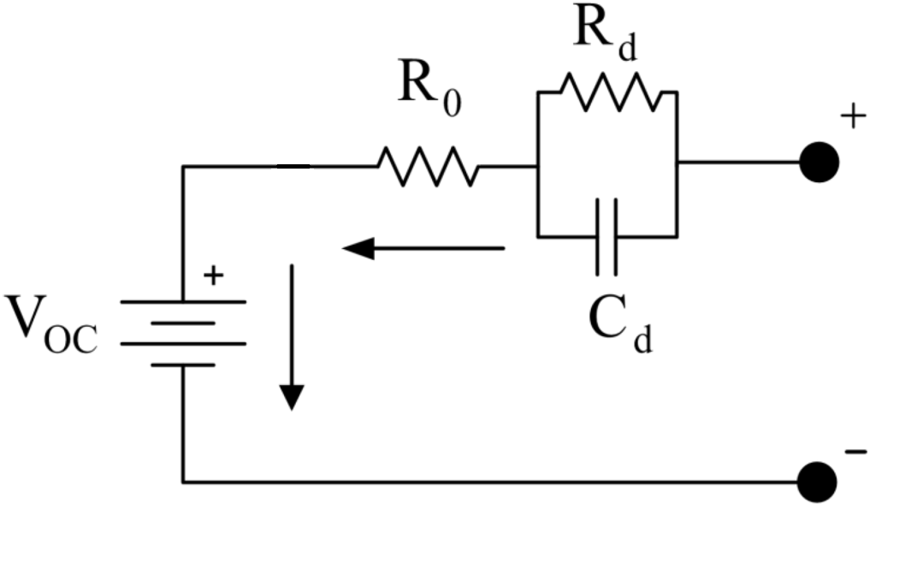
Planning
We will test batteries in some different situations. First, in the picture we can see the lithium ion battery model, which has a voltage source that charge the battery, and at the end, the points where you connect the load in order to discharge the battery
SOFTWARE
HARDWARE
INTERFACE
TEST
TEST
Blanca will made the interface of the program for control the batteries and the different tests.
Miguel will made the code for control the differents equipments to use in the test
We will made the differents test using the equipment like the vacuum chamber

Slide 4
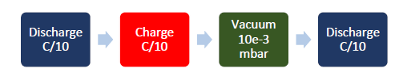
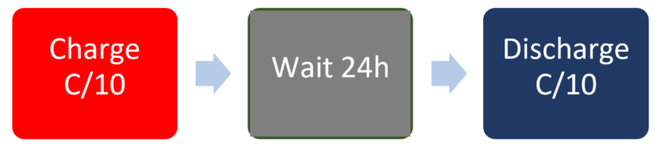
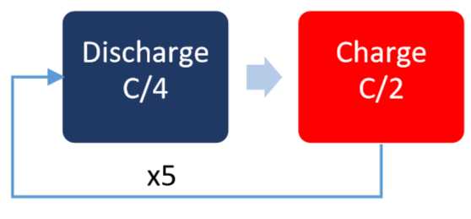
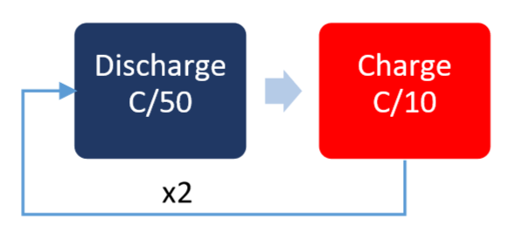
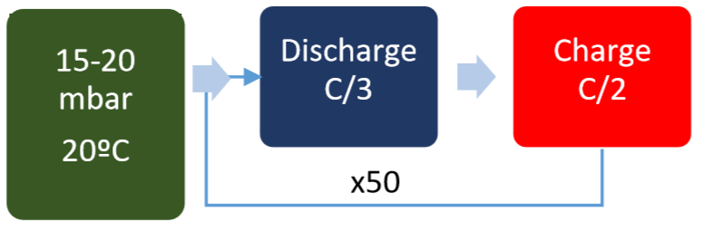
Test #1: High Vacuum Test
Test #2: Capacity and Internal Resistance vs Temperature
C → Measure of the rate at which a battery is discharged relative to its maximum capaity
Battery capacity versus temperature
Battery internal resistance versus temperature
Charging/ discharging voltage and current curves at different temperatures.
Battery size in charged and uncharged state
Battery capacity
Battery loss percentage after vacuum
Change in size after vacuum test
Test #3: Self-Discharge Test
Test #4: LEO Cycling
Battery degradation over continuous charge/discharge periods at border temperatures.
Battery charge/ discharge curve degradation.
Battery loss of energy over long periods.
Test #5: EMF vs SOC
Test #6-7: Reduced pressure 30 %/80% DOD Cycling
Battery curve of the electromotive force versus the state of charge
Evolution of EODV (End of Discharge Voltage) versus degradation.
Evolution of the battery capacity and efficiency versus degradation

Slide 5
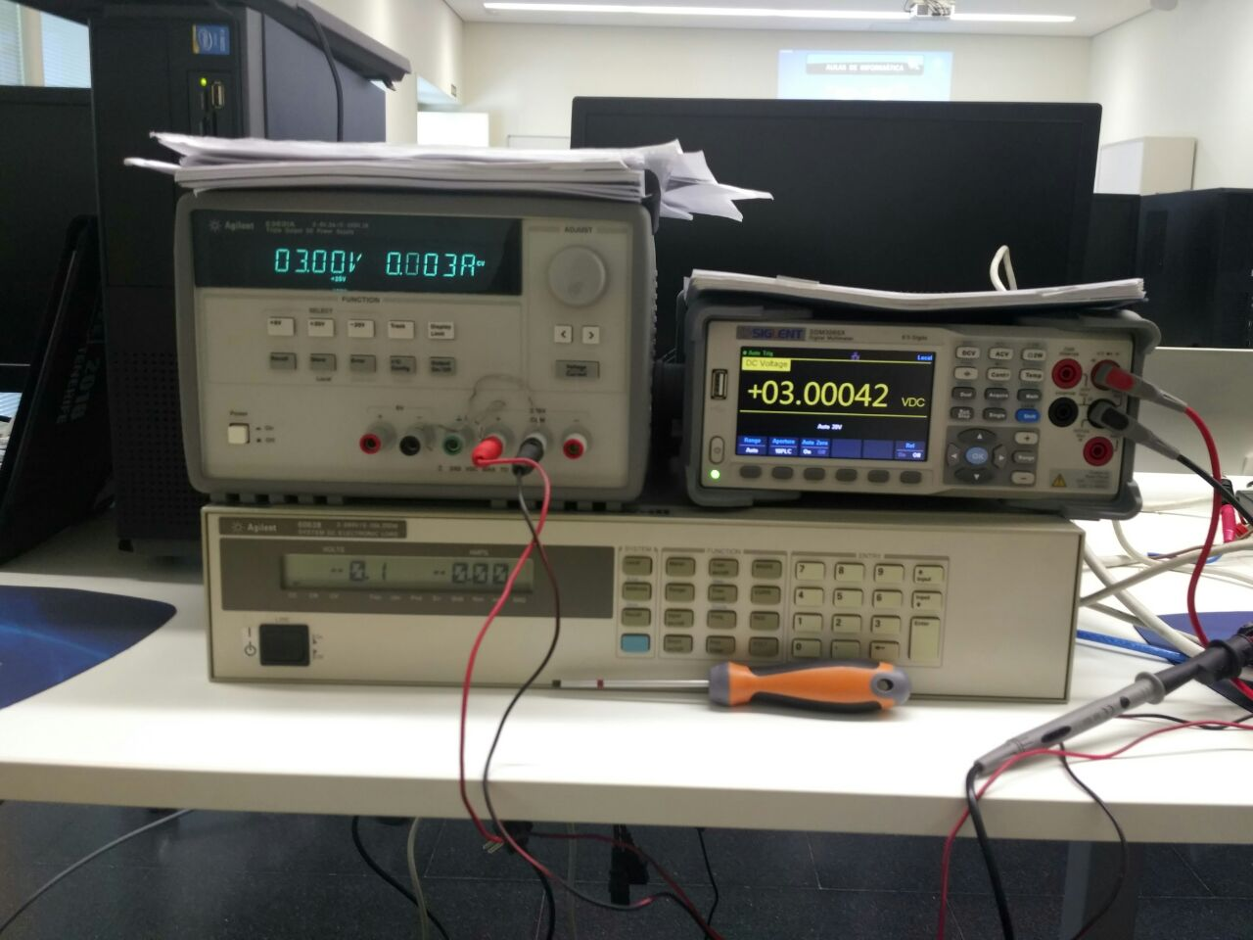
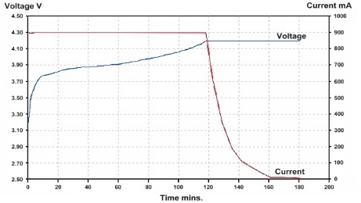
Equiptment Used
E3631A DC-Supply
The triple output supply offers three independent outputs: 0 to 6 V/5A, 0 to +25V/1A and 0 to –25V/1A. The 6 V output is electrically isolated from the ±25 V supply to minimize any interference between circuits under test. The ±25 V outputs can be set to track each other.
Multimeter SDM3065X
The multimeter read the voltage and current of the battery, and we use it because the 6063B DC-Load hasn’t got the same precision as the multimeter
6063B DC-Load
Current: 0 to 10 A
Volts: 3 to 240 V
Maximum power: 250 W

Slide 6
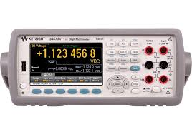
Multimeter control, software
Create our own class in python using visa libraries.
PLC value setting
Instrument comprobation
And value setting
PLC
Current
Average in time of
Current
Capacity
Work at 60hz
PLC value reading
voltage
Problems
Solutions
MEAS::CURR
Reconfigure all instrument
Create our own funtion of measure.

Slide 7
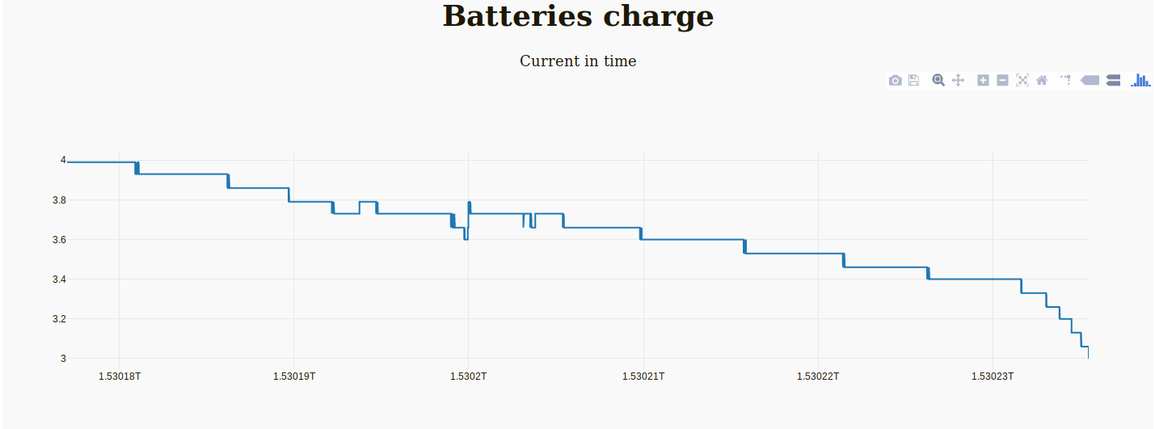
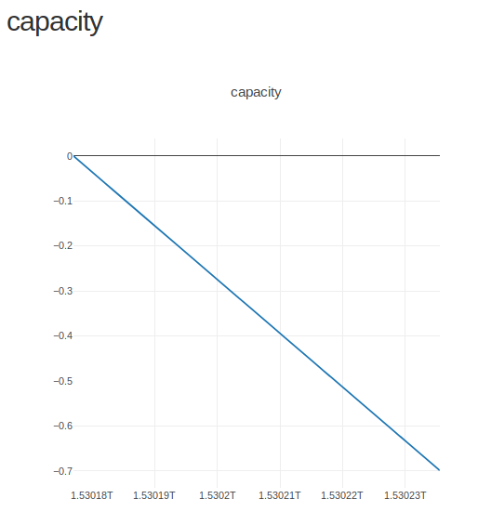
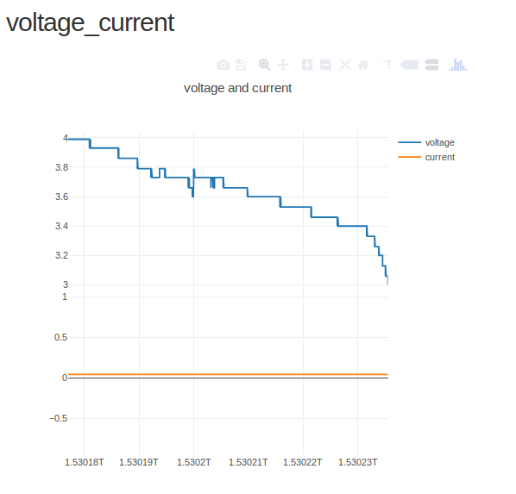
Interface evolution
ACTUAL APPROACH
Two graphics to measure current, voltage and capacity.
Posicionate moise over the graphic to know exactly data.
Posibility to export to png, pdf…
Zoom in, zoom aut
First approach
Make contact dash libray
Two decimal precision
Next implementation
Interactive visualization
Include checkboxes
Include buttons

Slide 8
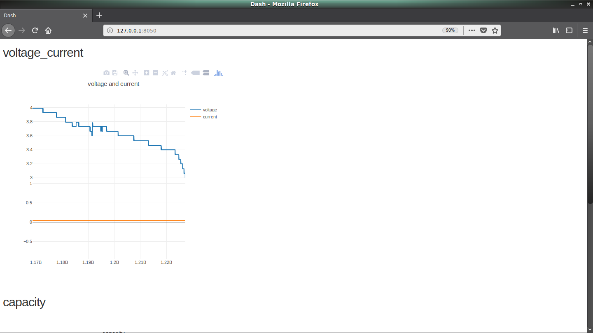
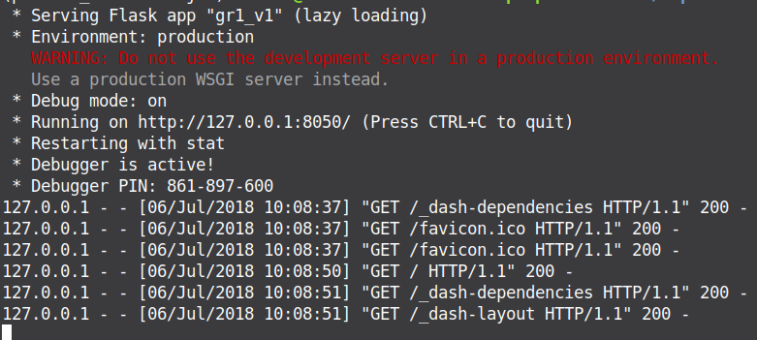

Python libraries in a virtual environment
Utilities
Installation
python3 -m pipenv shell
Libraries
Dash create our own server
Pandas: work with data
Plotly: graphic design
Design proyect
Select test type
Charge.csv data sheet
View result in real time
Stablish multimeter comunication
And control it
Error management

Slide 9

That is all
HAVE YOU ANY QUERY?

